Slide 1








Git Basics
Proudly recognized by

Slide 2
Git Introduction
Steps to Initialize Git Project
Git Branches and Commands
Git HEAD and Logs
Merging Branches and Resolve Conflicts
Revert and Reset
Git Stash
Rebase vs Merge
gitignore
Agenda

Slide 3
Git Introduction
The most widely used modern version control system in the world.
Git is a mature, actively maintained open source project originally developed in 2005 by Linus Torvalds, the famous creator of the Linux operating system kernel.

Slide 4
Steps To Initialize Git Project
Create account on Github.
Generate ssh key of your system and configure it in your Github account.
Create a new repository in your Github account.
Install git on your system.
For initialization of git project follow below steps:
Create a directory on your system.
Go inside the directory and execute command git init this must create .git directory in your folder.
Now copy and paste the remote address for ssh from your project on github account and execute the following command.
git remote add origin remote-url

Slide 5
Steps To Initialize Git Project
To configure ssh key with github account, follow these steps:
Generate ssh-key using below command:
ssh-keygen -t rsa -b 4096 -C "<your email address>"
Configure SSH key into github/gitlab account.
Clone the repository using below command.
git clone <SSH URL>

Slide 6
Git Branches and Commands
Start tracking a file
git add <filename>
Start tracking all the files
git add .
To commit code
git commit -m "your message"
Listing all branches
git branch

Slide 7
Git Branches and Commands
Create a new branch
git branch <branch-name>
Checkout to new branch
git checkout branch
Creating and moving to new branch
git checkout -b <branch-name>
Cloning a git project
git clone <remote-url>

Slide 8
Git Branches and Commands
Pushing to remote
git push remote-alias branch name
Pushing everything
git push --all
Pull changes from remote
git pull origin <branch name>
Fetch changes from remote
git fetch origin <branch name>

Slide 9
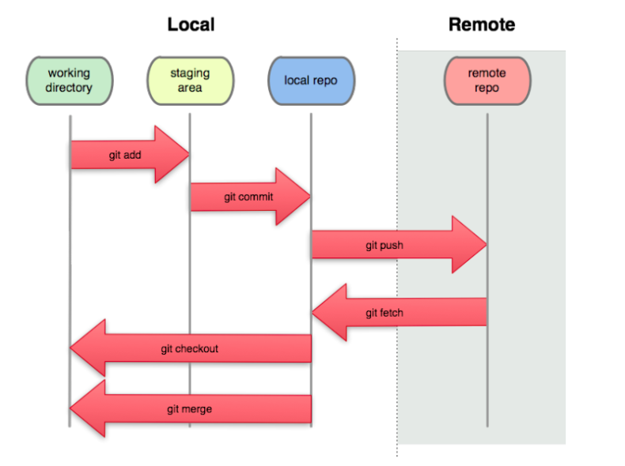
Git Flow

Slide 10
Git HEAD and Logs
HEAD is a reference to the current commit in the repository.
Current Commit Pointer:
HEAD always points to the latest commit in your current working branch.
For example, if you are on the main branch, HEAD points to the most recent commit in main.
Detached HEAD:
If you checkout a specific commit (not a branch), HEAD becomes "detached."
In this state, HEAD is not tied to any branch but directly points to the commit you checked out.
To see the changes committed on HEAD, run the following command:
git show HEAD

Slide 11
Git HEAD and Logs
Logs in Git, accessed via the git log command
Provide a detailed history of commits in a repository
A way to review and analyze the changes made to the codebase
Run the following command to get the logs history:
git log
Run the following command to limit git logs
git log -2

Slide 12
Merging Branches and Resolve Conflicts
Switch to the Target Branch
First, switch to the branch where you want to integrate changes:
git checkout <target branch>
Alternatively, for newer versions of Git:
git switch <target branch>
Merge the Source Branch
Use the git merge command to merge the source branch (the branch with the changes) into the target branch:
git merge <feature-branch>

Slide 13
Merging Branches and Resolve Conflicts
If there are conflicting changes between the branches, Git will pause the merge and show the conflicting files.
Open the conflicting files and manually resolve the conflicts
(Git marks them with <<<<<<<, =======, and >>>>>>>)
After resolving the conflicts, stage the changes:
git add conflicted-file
Complete the merge with:
git commit

Slide 14
Revert and Reset
Revert to a commit :
The git revert command undoes a committed snapshot, instead of removing the commit from the project history.
git revert <commit-hash>
Reset to a commit:
When you undo with git reset there is no way to retrieve the original copy—it is a permanent undo.
git reset <commit-hash>
Options with reset
--soft : staged changes ready to be committed
--mixed : Unstaged changes ready to be changed and commited
--hard : you will not be able to see changes anywhere

Slide 15
Git Stash
git stash temporarily saves your changes in a working directory without committing them
Useful when you want to switch branches or work on something else but aren’t ready to commit your changes.
Stash your changes:
git stash
Optionally, include a message:
git stash save "Work in progress on feature"
List all stashes:
git stash list
Apply the most recent stash:
git stash apply

Slide 16
Git Stash
Apply a specific stash:
git stash apply stash@{1}
Apply and remove the most recent stash:
git stash pop
Drop a specific stash:
git stash drop stash@{0}
Clear all stashes:
git stash clear

Slide 17
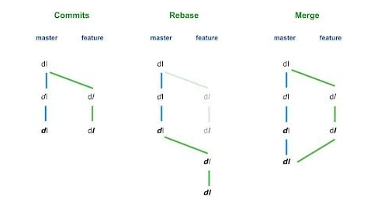
Rebase vs Merge

Slide 18
Rebase vs Merge
Both git rebase and git merge are used to integrate changes from one branch into another, but they do so in different ways.
Git Merge
Combines two branches while preserving the commit history.
Creates a merge commit, which represents the point where the branches merged.
Maintains the context of the original branch, showing a branch history with all commits intact.
Git Rebase
Moves the commits of one branch on top of another, rewriting history.
No merge commit is created; instead, the commits are applied sequentially.
Results in a cleaner, linear history.

Slide 19
gitignore
A .gitignore file is used to tell Git which files and directories should be ignored in a repository. This prevents unnecessary or sensitive files from being tracked by Git.
Avoid committing temporary files (e.g., logs, cache files, compiled code).
Ignore environment-specific files (e.g., .env, .DS_Store, node_modules/).
Prevent accidental commits of sensitive data (e.g., API keys, credentials).

Slide 20
Assignment
Configure SSH key in github account.
Create a repository on github account.
Clone the above repository on your local from github.
Create a new file, say test.txt, in main/master branch. Make some changes to this file and commit the changes.
Create two branches from main/master branch, say f1 and f2.
How can you resolve a merge conflict in Git, provide an example.
Show how divergence occurs in a branch.

Slide 21
Assignment
8. Difference between git init and git clone.
9. Difference between git branch and git checkout.
10. Difference between git fetch and git pull.
11. How to squash commits?
12. Show the difference between git reset and git revert.
13. Delete branch from local and remote.

Slide 22
Thank You

